Slide 1
Discount IMDb
Joe Boutte, Anastasia King, Brayan Quezada, Anson Jones, Ian Riley, Alexander Dubrovsky

Slide 2
Movie Database
Searchable and modifiable database of 4872 movies
It contains the title, director, budget, profit, top 3 actors, language, content rating, genre, etc.
Based on datasets available from IMDB.

Slide 3
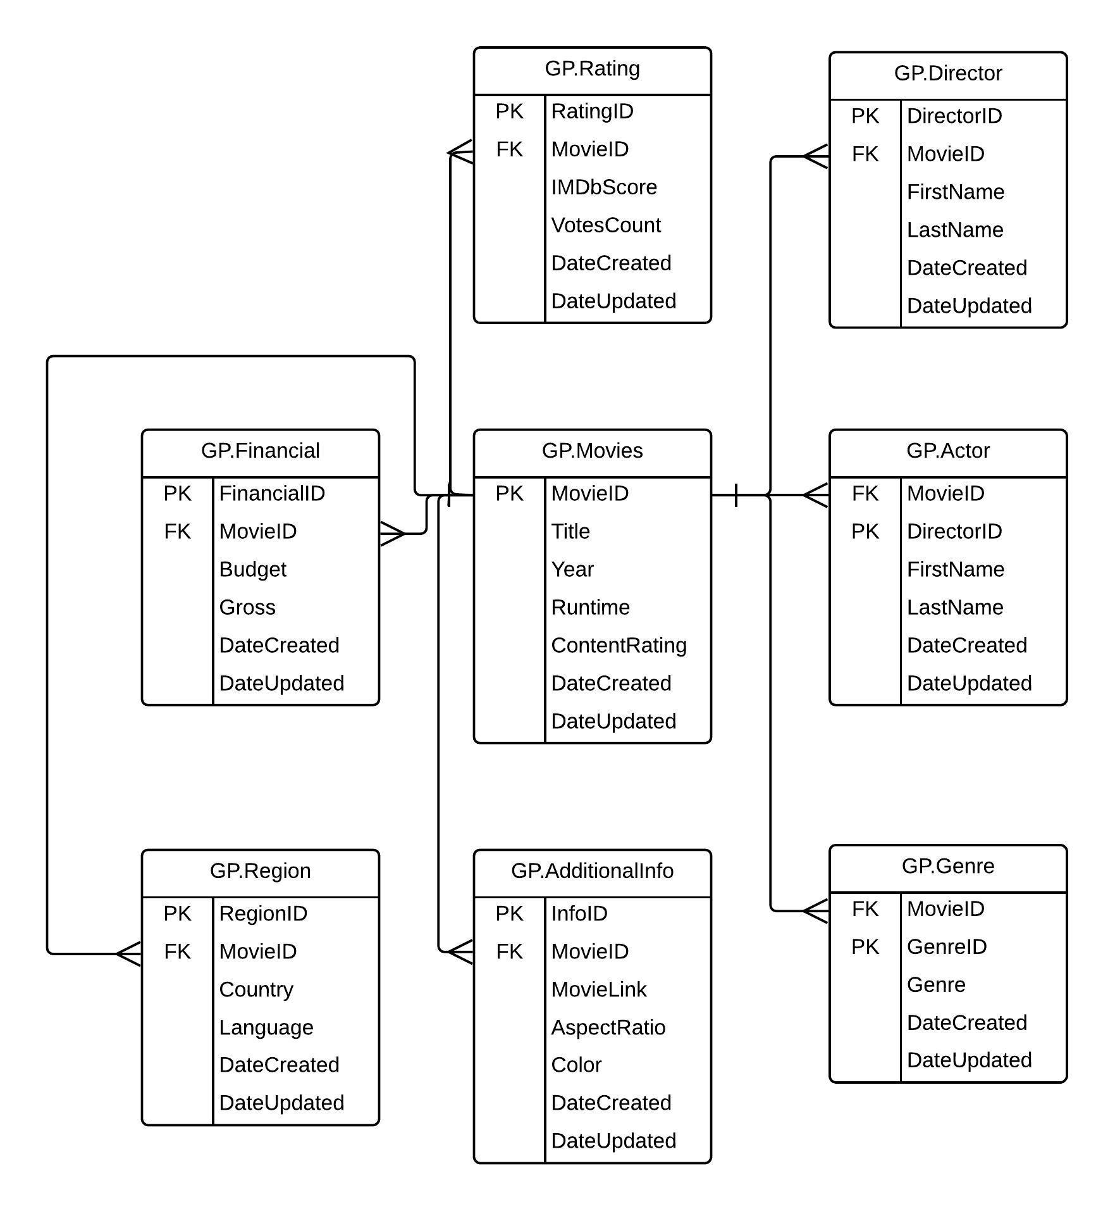
Our Design

Slide 4
The Nitty, Gritty Details
We used a SQL database (obviously) for storing the movie information and SQL queries to return information based on what the user is searching for
We made a C# program to act as our front-end for user interaction as well as data entry. The GUI has an admin mode that allows for the entry, and modification of movie details

Slide 5
Why People Would Use It
The target users for this are anybody who watches movies as it can be used to find movies that have the same actor, director, or genre
Almost every piece of data is searchable so you could find movies based on rating, runtime, or content rating

Slide 6
Ideas for the Future
More Movies
Include a system for users to review movies that exist in the system
Create an API that allows people to pull information from our database for their own uses
Create user accounts so that users can save their favorite movies or even create multiple lists for their movies
Smartphone app

Slide 7
Difficulties
Importing data into the database
GUI design, matching with procedures
Matching procedures with desired query

Slide 8
Demo

Slide 9
Questions?

